Slide 1
PORTFOLIO PROJECT · AI IMPLEMENTATION
Automating Acquisition
Underwriting Intake with AI
A custom Claude AI skill that reads any operator's rent roll and P&L, applies the firm's underwriting logic, and loads a live acquisition proforma in minutes — built end-to-end for the Hamister Group Acquisitions team.
~92%
286 hrs
$0.00
faster deal intake
reclaimed per year
NOI audit variance
Senior Housing Acquisitions · 2026

Slide 2
THE PROBLEM
Every deal began with two hours of manual re-keying
No two operators alike
✖
Rent rolls and P&Ls arrive as Yardi exports, QuickBooks dumps, legacy .xls files, even 13-month rolling statements with months in reverse order.
2 hrs
Judgment buried in busywork
of skilled analyst time per deal —
before underwriting even began
✖
Analysts hand-tagged 100+ P&L lines, deduped shared rooms bed-by-bed, and rebuilt trailing-twelve and T3A columns for every single deal.
3 intakes per week · every format different · zero reusability
Errors surfaced late
✖
A mistyped keyword or a missed move-out only appeared when the proforma NOI wouldn't tie — often hours later, deep in the model.
AI UNDERWRITING INTAKE — HAMISTER GROUP ACQUISITIONS
2

Slide 3
THE SOLUTION
One AI skill, three engines, a live model at the end
RAW DEAL FILES
CLAUDE SKILL — proforma-sort-and-fill-senior
LIVE DELIVERABLE
Rent Roll
Rent Roll Engine
Any operator export — .xls, .xlsx, .csv, .pdf; bed-level detail, mixed statuses
Room-level dedupe (beds → rooms) · end-of-month occupancy projection · canonical unit typing · rate reconstruction
Acquisition Proforma
Raw data embedded as new tabs
Inputs tables filled by live formulas
Macros & model logic untouched
Financials Engine
25-keyword taxonomy tagging · TTM / T3A / T3A-TTM timeline builder · handles reversed month order
Financial Statement
P&L / trailing-12 / 13-month rolling; 100+ line items, any chart of accounts
Self-Audit Layer
NOI tied to source to the penny · occupancy cross-check vs operator summary · every judgment call reported
Runs live in the Excel sidebar (writes straight into the open workbook) or standalone in chat with graceful file-mode fallback — same result either way.
AI UNDERWRITING INTAKE — HAMISTER GROUP ACQUISITIONS
3

Slide 4
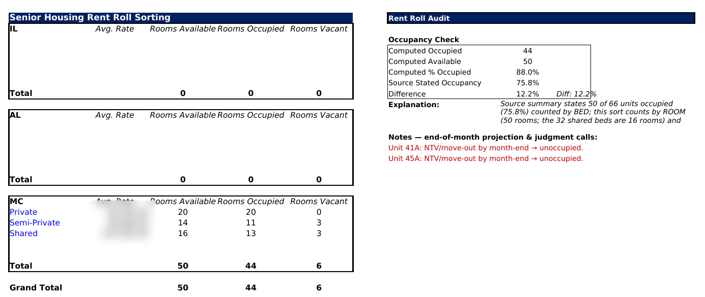


ENGINE 1 · RENT ROLLS
From bed-level chaos to a room-true occupancy picture
1
Rooms, not beds
Collapses bed suffixes (01A/01B → room 01) so shared units count once — the operator said 66 units; the true room count is 50.
2
Month-end projection
Occupancy is projected to the rent-roll month end: notices-to-vacate come out, signed move-ins count in.
3
Explains itself
The audit panel reconciles to the operator's own summary and lists every judgment call in red.
Actual skill output — sorted rent roll with built-in audit. Confidential data redacted.
50 ROOMS TRUE
88% OCCUPIED
2 FLAGS RAISED
AI UNDERWRITING INTAKE — HAMISTER GROUP ACQUISITIONS
4

Slide 5
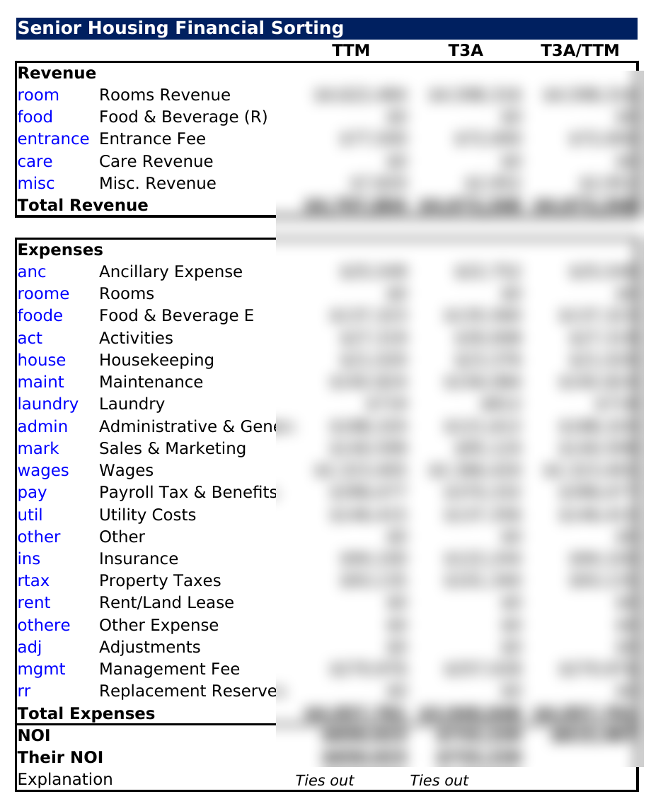
ENGINE 2 · FINANCIALS
120+ P&L lines tagged, NOI tied to the penny
25-keyword taxonomy
Timeline intelligence
Five revenue and twenty expense buckets encode the firm's chart-of-accounts logic — department wages roll to wages, resident-billed services to rooms revenue, below-NOI items excluded.
Detects what the source supports and builds only that: calendar years, trailing-twelve, T3A run-rate, and the underwriting blend (T3A revenues over TTM expenses).
Hostile-format proof
Self-catching
The test statement was a 13-month rolling export with months newest-first — the engine excluded the stray 13th month and summed the right twelve.
The NOI tie-out flagged a $405 leak from one untagged mileage line mid-run — found and fixed before a human ever saw the output.
Actual output — dollar values redacted.
AI UNDERWRITING INTAKE — HAMISTER GROUP ACQUISITIONS
5

Slide 6
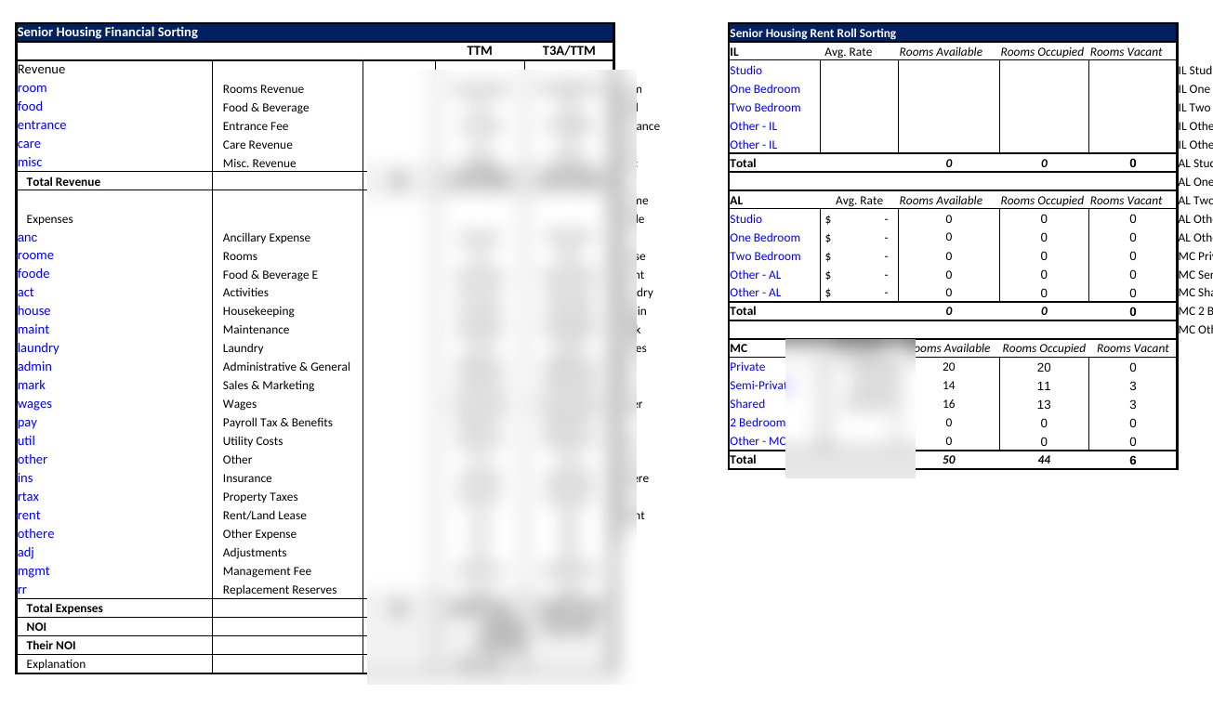

THE PAYOFF
The proforma fills itself — with formulas, not pasted numbers
Source data embedded
Raw rent roll and P&L become tabs inside the model, keyword-tagged.
Living formulas
SUMIF / AVERAGEIFS references — retag one line and the model updates instantly.
Surgical writes
Only the two input tables are touched; every model formula and VBA macro survives.
The model's Inputs tab, filled by the skill — financials redacted.
AI UNDERWRITING INTAKE — HAMISTER GROUP ACQUISITIONS
6

Slide 7
UNDER THE HOOD
Engineered like software, documented like a product
⚙
Format-agnostic parsing
⇄
Dual-mode execution
✓
Verification-first design
Maps columns by meaning, not position — legacy .xls, reversed months, missing rate columns all handled.
Detects the Excel sidebar and writes live into the open workbook; falls back to file mode in plain chat.
Every run recomputes results independently, then confirms the written formulas evaluate to the same numbers.
⛨
Model-safe by contract
▤
Knowledge encoded
⬆
Shareable & versioned
Scans for tables by title (never hardcoded cells), preserves macros, and guarantees an explicit touch-nothing-else list.
The firm's classification rulebook ships inside the skill.
Packaged as a single .skill file any teammate installs once. Plus, a one-page rollout guide written for new users.
AI UNDERWRITING INTAKE — HAMISTER GROUP ACQUISITIONS
7

Slide 8
IMPACT · SPEED
Two hours of intake compressed to roughly ten minutes
~92%
reduction in intake time per deal
110 minutes handed back to the analyst on every deal — redirected from re-keying to actual underwriting judgment.
AI UNDERWRITING INTAKE — HAMISTER GROUP ACQUISITIONS
8

Slide 9
IMPACT · COST
286 hours and $5,400 saved, every single year
$5,434
saved per year in intake labor alone
286 analyst-hours redeployed to other work
ASSUMPTIONS
3 deal intakes per week, 52 weeks
$19 / hr analyst rate
120 min manual → 10 min with AI
AI UNDERWRITING INTAKE — HAMISTER GROUP ACQUISITIONS
9

Slide 10
WHAT THIS PROJECT DEMONSTRATES
AI that carries real
underwriting weight
AI skill architecture
Domain translation
Designed, built, and versioned a production Claude skill — three iterations from prototype to shareable tool.
Encoded the firm's underwriting conventions — room-level occupancy, keyword taxonomy, timeline blends — into repeatable machine logic.
Financial-model automation
Change enablement
Live Excel integration that respects a complex macro-driven proforma and fills it with auditable formulas.
Shipped with verification runs on real deals, an NDA-safe rollout doc, and a one-page guide any new hire can follow.
Built for the Hamister Group Acquisitions team · financial details redacted under NDA

