Slide 1

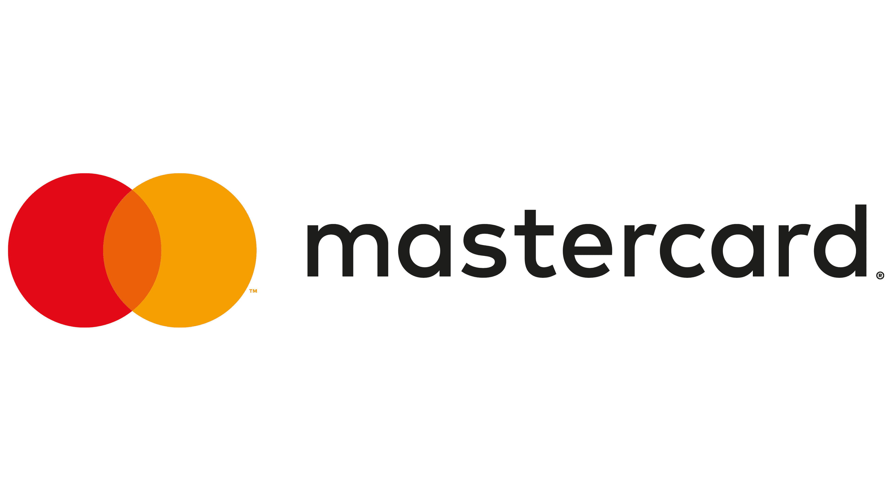


Financials: Asset Managers & Payments & Real Estate Re-Evaluation
Current Portfolio Holdings
&
Analyst
Myles Manoli

Slide 2
Hold
Hold
Investment Thesis
BlackRock is a scale-driven, fee-based asset manager positioned to benefit from long-term growth in global financial markets, continued inflows into passive investment products, and increasing demand for institutional portfolio management and risk analytics.
High margin, asset light payments network that benefits from the global transition from cash to digital payments, growing transaction volumes, and strong network effects that create a durable competitive moat.
Equity Market Appreciation
Higher market levels directly increase AUM and fee revenue
Continued ETF Inflows
Structural shift toward passive investing drives steady inflows
Institutional Adoption of Aladdin
Expansion of technology platform increases high-margin revenue share
Key Catalysts
Secular Shift to Digital Payments
Long-term decline of cash globally
Cross-Border Transactions
High-margin revenue stream tied to global travel and commerce
Network Effects
More users, more merchants, stronger ecosystem
Analyst
Myles Manoli

Slide 3
BlackRock is the world’s largest asset manager, serving institutions and individuals by allocating capital across global financial markets. The firm offers a broad range of investment products, including ETFs, mutual funds, and alternative strategies, as well as a software product used for PM.
Investment Advisory, Administration Fees & Securities Lending (79%)
BlackRock’s main revenue source, earned as a percentage of assets under management across funds and ETFs; revenue grows with market performance and investor inflows, and includes income from lending securities.
Investment Advisory Performance Fees (6%)
Fees earned when certain funds outperform benchmarks, meaning revenue depends on investment performance and is less consistent.
BlackRock Solutions & Advisory (8%)
Revenue from Aladdin and advisory services, providing portfolio analytics to institutions; high-margin and more stable than asset-based fees.
Distribution Fees (6%)
Fees tied to distributing BlackRock’s products through brokers and advisors, supporting access to a wide investor base.
Other Revenue (1%)
Minor income from miscellaneous sources that are not core to the business.
$152B
27.67
Apr. 10th
1.49
$976
Mrkt Cap
Price P.S.
Beta
P/E
Q1 Earnings
Metrics
Mrkt Cap
Price P.S.
Beta
Avg Volume
Q1 Earnings
Metrcs

Slide 4
Key Events
Jan 12, 2024:Q4 Earnings & Strong Inflows
Strong results driven by ETF inflows and higher AUM, reinforcing BlackRock’s scale and market leadership.
Stock impact: +2 to 3% (positive earnings reaction)
Jan 27 – Feb 10, 2025: Broad Market Selloff
No company-specific catalyst; decline driven by global equity weakness and AUM sensitivity to falling markets.
Stock impact: −18 to 20% (sharp macro-driven drawdown)
Mar 31 – Apr 3, 2025: Failed Rebound
Short-term bounce driven by oversold conditions and quarter-end flows, followed by renewed selling as macro pressures persisted.
Stock impact: +2–3% rebound, then −10–12% continuation lower)
$152B
27.67
Apr. 10th
1.49
$976
Mrkt Cap
Price P.S.
Beta
P/E
Q1 Earnings
Metrics

Slide 5
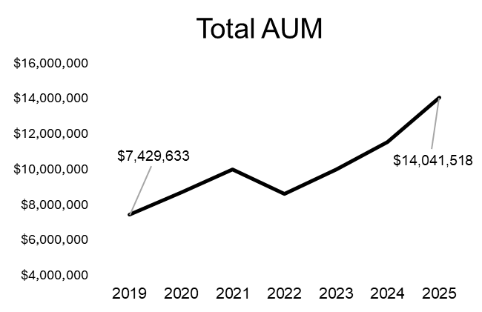
BlackRock has demonstrated steady revenue and EPS growth over the past 5 years, primarily driven by higher AUM and operating leverage. Growth has been somewhat cyclical, with periods of market volatility impacting results, but overall earnings expansion remains intact and aligned with long-term expectations.
AUM growth has been driven by a combination of market appreciation and continued inflows into ETFs, reinforcing BlackRock’s scale advantage. Margins have remained relatively stable, reflecting the firm’s ability to manage costs while growing revenue, although some pressure from fee compression and product mix shifts remains a key area to monitor.
Data in Millions*
$152B
27.67
Apr. 10th
1.49
$976
Mrkt Cap
Price P.S.
Beta
P/E
Q1 Earnings
Metrics

Slide 6


Geopolitical & Macro Risk
Ongoing Middle Eastern Tension risking higher oil prices leading to a potential global recession trigger
Disruption to energy supply chains causing inflation
Broader geopolitical tension such as China & US tensions reshaping global markets
High
Medium
Policy & Regulatory Risk
Rising government intervention
ESG/political backlash
Low
Medium
High
Impact
Market Structure & Liquidity Risk
Growth in private credit introduces liquidity risks
Recent fund withdrawal restrictions triggered investor concern about private credit stability
Tech & Structural Risk
AI could widen wealth inequality leading to political backlash or policy intervention
Potential asset bubbles in AI driven equities

Slide 7
Fall 2025 DCF

Slide 8
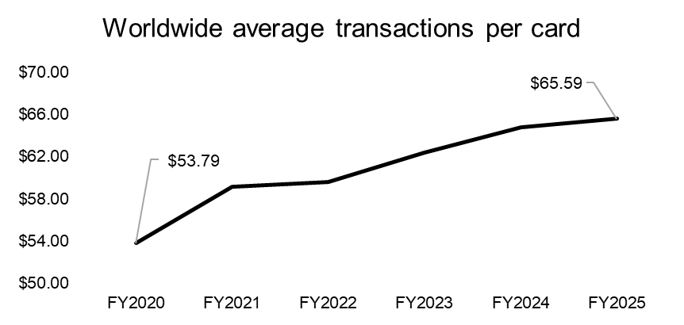
Mastercard makes money by operating the payment network that connects consumers, banks, and merchants when a transaction takes place. When you tap or swipe a card, Mastercard’s network is what securely routes the information between the issuing bank (the customer’s bank) and the merchant’s bank to approve and settle the payment. For enabling this process, Mastercard earns fees on each transaction, as well as additional revenue from cross-border payments, fraud prevention, and data-related services.
Because it doesn’t actually lend money or issue cards, Mastercard avoids taking on credit risk. Instead, its revenue is driven by the volume and value of transactions flowing through its network, meaning it benefits directly from increased consumer spending and the continued shift toward electronic payments.
Data in Millions*
$441B
29.90
Apr. 30th
.84
$494
Mrkt Cap
Price P.S.
Beta
P/E
Q1 Earnings
Metrics

Slide 9
Key Events
Oct 26, 2023: Q3 Earnings Beat
Strong quarterly results driven by cross-border volume growth and resilient consumer spending. Reinforced Mastercard’s exposure to global travel recovery.
Stock impact: +5 to 6% (positive re-rating on growth outlook)
Mar 25, 2024: $30B Interchange Fee Settlement
Antitrust settlement with merchants raised concerns about long-term fee structure and pricing power.
Stock impact: −3 to -4% (regulatory overhang on margins)
$441B
29.90
Apr. 30th
.84
$494
Mrkt Cap
Price P.S.
Beta
P/E
Q1 Earnings
Metrics

Slide 10
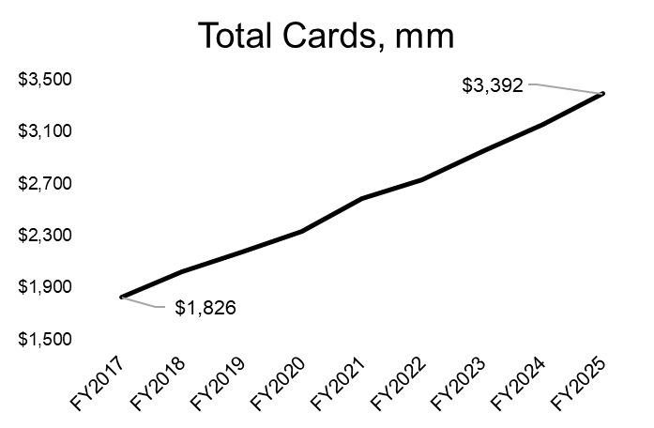
Mastercard’s financial performance reflects strong profitability, with consistent earnings growth and margin expansion over the past 3 years. Revenue and EPS have trended upward alongside increasing transaction volumes. Dividend growth remains stable supported by reliable free cash flow although growth in their dividend payout has plateaued this year, and despite some variability from macro conditions, the company continues to demonstrate stable, high-quality earnings.
Data in Millions*
$152B
27.67
Apr. 10th
1.49
$976
Mrkt Cap
Price P.S.
Beta
P/E
Q1 Earnings
Metrics

Slide 11

High
Geopolitical Risk
Payment networks can be cut off due to geopolitical conflict
Europe and UK actively building alternatives to reduce reliance on Mastercard
Medium
Competitive/Technological Disruption
Real-time payments and open banking creating new pipelines outside card networks with
Crypto and blockchain payments emerging as alternatives
Low
Medium
High
Impact
Antitrust Risk
U.S. push for the Credit Card Competition Act
Ongoing antitrust scrutiny in U.S. and Europe over “duopoly” power
Merchant and regulators pushing to cap fees or increase transparency
Political & Regulatory Pressure
FTC warning over “debanking” leading to potential enforcement if access to service is restricted (This is due to financial service companies denying customers access to services due to their political or religious views)

Slide 12
Assumed Exit Multiple |  |  |  | 14.0x
Equity Value
Total Debt |  |  |  | 41,013
Net Debt Calculation
Total Balance Sheet Cash |  |  |  | 10,566
Minimum Cash to Run Business |  |  |  | 5,000
Excess Available Cash |  |  |  | 5,566
Net Debt |  |  |  | 35,447
Calculating Price per Share
Total Enterprise Value (Exit Multiple Method) |  |  |  | 710,968.23
Less: Net Debt |  |  |  | (35,447)
Equity Value |  |  |  | 675,521.23
Fully Diluted Shares |  |  |  | 906
Implied Price per Share using Exit Multiple Method |  |  |  | $745.61
Upside/Downside to current price |  |  |  | 48.5%
Average Implied Price Per Share |  |  |  | $678.67
Upside/Downside to current price |  |  |  | 35.1%
WACC | 7.68%
Equity Value
Total Debt |  |  |  | 41,013
Net Debt Calculation
Total Balance Sheet Cash |  |  |  | 10,566
Minimum Cash to Run Business |  |  |  | 5,000
Excess Available Cash |  |  |  | 5,566
Net Debt |  |  |  | 35,447
Calculating Price per Share
Total Enterprise Value (Perpetuity Method) |  |  |  | 589,676.29
Less: Net Debt |  |  |  | (35,447)
Equity Value |  |  |  | 554,229.29
Fully Diluted Shares |  |  |  | 906
Implied Price per Share using Perpetual Growth |  |  |  | $611.73
Upside/Downside to current price |  |  |  | 21.8%
Average Implied Price Per Share |  |  |  | $678.67
Upside/Downside to current price |  |  |  | 35.1%

Slide 13



Summary
Biggest Risk:
If liquidity risks continue especially in a market downturn, people will be hesitant to invest their money, especially in riskier assets.
Biggest Risk:
If Europe and the UK are successful in moving away from Mastercard this will cause a major disturbance in their performance.
BlackRock is a scale story that’s tied directly to the growth of global markets and the continued shift toward passive investing. As more money flows into ETFs and investment products, BlackRock is in the best position to capture that because of its size and distribution. On top of that, the Aladdin platform adds another layer to the business, so we are not just relying on markets going up, there is also a technology component.
Mastercard is a long-term bet on the world moving away from cash and toward digital payments. Every time people spend more, travel more, or transact online, Mastercard benefits without taking on credit risk, which makes the model incredibly efficient. With strong network effects and high margins, it’s a business that can keep compounding over time as global payment volumes continue to grow throughout the world.

Slide 14
data from Tegus in $ millions
 | FY2021 | FY2022 | FY2023 | FY2024 | FY2025 | FY2026 | FY2027 | FY2028 | FY2029 | FY2030
Revenue | $ 18,884.00 | $ 22,237.00 | $ 25,098.00 | $ 28,167.00 | $ 32,791.00 | $ 37,198.14 | $ 41,865.05 | $ 46,799.94 | $ 53,038.03 | $ 60,162.42
Growth Rate % |  | 17.76% | 12.87% | 12.23% | 16.42% | 13.44% | 12.55% | 11.79% | 13.33% | 13.43%
Cost of Goods Sold | 0.00 | 0.00 | 0.00 | 0.00 | 0.00 | 0.00 | 0.00 | 0.00 | 0.00 | 0.00
Gross Profit | 18,884.00 | 22,237.00 | 25,098.00 | 28,167.00 | 32,791.00 | 37,198.14 | 41,865.05 | 46,799.94 | 53,038.03 | 60,162.42
Operating Expenses | 9,075.00 | 10,268.00 | 11,550.00 | 13,111.00 | 14,491.00 | 15,524.87 | 16,980.08 | 17,473.91 | 17,982.55 | 18,506.46
EBIT | 9,809.00 | 11,969.00 | 13,548.00 | 15,056.00 | 18,300.00 | 21,673.27 | 24,884.97 | 29,326.03 | 35,055.47 | 41,655.96
Operating Margin % | 51.9% | 53.8% | 54.0% | 53.5% | 55.8% | 58.3% | 59.4% | 62.7% | 66.1% | 69.2%
Tax Provision (Benefit) | 1,620.00 | 1,802.00 | 2,444.00 | 2,380.00 | 3,610.00 | 4,254.97 | 4,879.68 | 5,750.10 | 6,890.12 | 8,204.17
Tax-affected EBIT | 8,189.00 | 10,167.00 | 11,104.00 | 12,676.00 | 14,690.00 | 17,418.30 | 20,005.29 | 23,575.93 | 28,165.36 | 33,451.79
Add Back: D&A (non-cash expense) | 999.00 | 1,045.00 | 1,259.00 | 1,423.00 | 1,740.00 | 1,485.90 | 1,530.48 | 1,576.39 | 1,623.68 | 1,672.39
Tax-affected EBIT + D&A | 9,188.00 | 11,212.00 | 12,363.00 | 14,099.00 | 16,430.00 | 18,904.20 | 21,535.77 | 25,152.32 | 29,789.04 | 35,124.19
Margin % | 48.7% | 50.4% | 49.3% | 50.1% | 50.1% | 50.8% | 51.4% | 53.7% | 56.2% | 58.4%
Less: Capex | 0.00 | 0.00 | 0.00 | 0.00 | 0.00 | 420.00 | 420.00 | 420.00 | 420.00 | 420.00
Plus / (Less) Change in NWC | 1,144.00 | 844.00 | 40.00 | 76.00 | (109.00) | 0.00 | 0.00 | 0.00 | 0.00 | 0.00
Unlevered Free Cash Flow | 10,332.00 | 12,056.00 | 12,403.00 | 14,175.00 | 16,321.00 | 19,324.20 | 21,955.77 | 25,572.32 | 30,209.04 | 35,544.19
Growth % |  | 16.7% | 2.9% | 14.3% | 15.1% | 18.4% | 13.6% | 16.5% | 18.1% | 17.7%

Slide 15
Basic Capitalization Table
Short-term debt | 22,762
Long-term debt | 18,251
Total Debt | 41,013
Total Diluted Shares Outstanding | 906
Current Share Price | $502.23
Total Equity Value | 455,020
Total Capitalization | 496,033
Debt as a % of Total Capitalization | 8.3%
Equity as a % of Total Capitalization | 91.7%
Cost of Debt
Debt Financing Interest Rate | 5.06%
Corporate Tax Rate (debt shield) | 21.0%
Tax-affected Cost of Debt | 4.0%
Cost of Equity
Risk-free Rate | 4.31%
Equity Risk Premium | 4.46%
Levered Beta | 0.83
Cost of Equity | 8.0%
Weighted Average Cost of Capital | 7.7%
 | FY2021 | FY2022 | FY2023 | FY2024 | FY2025 | FY2026 | FY2027 | FY2028 | FY2029 | FY2030
Revenue | $18,884.00 | $22,237.00 | $25,098.00 | $28,167.00 | $32,791.00 | $37,198.14 | $41,865.05 | $46,799.94 | $53,038.03 | $60,162.42
Growth % YoY |  |  | 13% | 12% | 16% | 13% | 13% | 12% | 13% | 13%
Cost of Goods Sold | 0.00 | 0.00 | 0.00 | 0.00 | 0.00 | 0.00 | 0.00 | 0.00 | 0.00 | 0.00
Gross Profit | 18,884.00 | 22,237.00 | 25,098.00 | 28,167.00 | 32,791.00 | 37,198.14 | 41,865.05 | 46,799.94 | 53,038.03 | 60,162.42
Gross Margin % | 100% | 100% | 100% | 100% | 100% | 100% | 100% | 100% | 100% | 100%
General and administrative | 7,087.00 | 8,078.00 | 8,927.00 | 10,193.00 | 11,318.00 | 12,562.98 | 13,944.91 | 14,363.26 | 14,794.15 | 15,237.98
Advertising and marketing | 895.00 | 789.00 | 825.00 | 815.00 | 929.00 | 956.87 | 985.58 | 1,015.14 | 1,045.60 | 1,076.97
Provision for litigation settlement | 94.00 | 356.00 | 539.00 | 680.00 | 504.00 | 519.12 | 519.12 | 519.12 | 519.12 | 519.12
D&A | 726.00 | 750.00 | 799.00 | 897.00 | 1,143.00 | 1,485.90 | 1,530.48 | 1,576.39 | 1,623.68 | 1,672.39
Operating Expenses | 8,802.00 | 9,973.00 | 11,090.00 | 12,585.00 | 13,894.00 | 15,524.87 | 16,980.08 | 17,473.91 | 17,982.55 | 18,506.46
EBIT | 10,082.00 | 12,264.00 | 14,008.00 | 15,582.00 | 18,897.00 | 21,673.27 | 24,884.97 | 29,326.03 | 35,055.47 | 41,655.96
Operating Margin % | 53% | 55% | 56% | 55% | 58% | 58% | 59% | 63% | 66% | 69%
Interest expense | (431.00) | (471.00) | (575.00) | (646.00) | (722.00) | (801.42) | (889.58) | (978.53) | (1,007.89) | (1,038.13)
Investment income | 11.00 | 61.00 | 274.00 | 327.00 | 325.00 | 325.00 | 325.00 | 325.00 | 325.00 | 325.00
Gains (losses) on equity investments, net | 645.00 | (145.00) | (61.00) | (29.00) | (88.00) | (88.00) | (88.00) | (88.00) | (88.00) | (88.00)
Other income (expense), net | 0.00 | 23.00 | (7.00) | 20.00 | 166.00 | 166.00 | 0.00 | 0.00 | 0.00 | 0.00
EBT | 10,307.00 | 11,732.00 | 13,639.00 | 15,254.00 | 18,578.00 | 21,274.85 | 24,398.39 | 28,750.50 | 34,450.58 | 41,020.83
Tax Rate | 15.72% | 15.36% | 17.92% | 15.60% | 19.43% | 20.00% | 20.00% | 20.00% | 20.00% | 20.00%
Income tax expense | 1,620.00 | 1,802.00 | 2,444.00 | 2,380.00 | 3,610.00 | 4,254.97 | 4,879.68 | 5,750.10 | 6,890.12 | 8,204.17
Error Fix | (0.79) | (0.79) | (0.74) | (0.71) | (0.67)
Net Income | 8,414.79 | 9,635.79 | 10,735.74 | 12,348.71 | 14,371.67 | 17,019.88 | 19,518.71 | 23,000.40 | 27,560.47 | 32,816.67
NCI & Other | 0.00 | 0.00 | 0.00 | 0.00 | 0.00 | 0.00 | 0.00 | 0.00 | 0.00 | 0.00
Net Income to UBER | 8,414.79 | 9,635.79 | 10,735.74 | 12,348.71 | 14,371.67 | 17,019.88 | 19,518.71 | 23,000.40 | 27,560.47 | 32,816.67

Slide 16
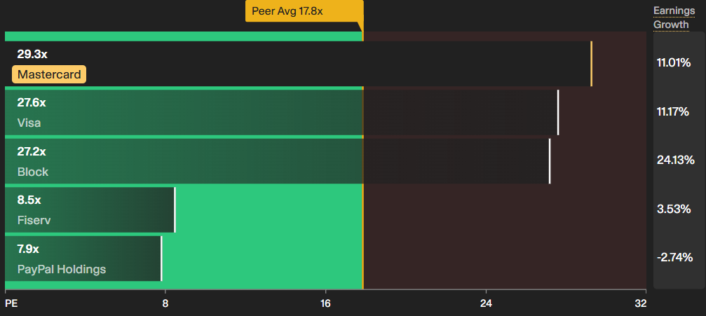

Slide 17
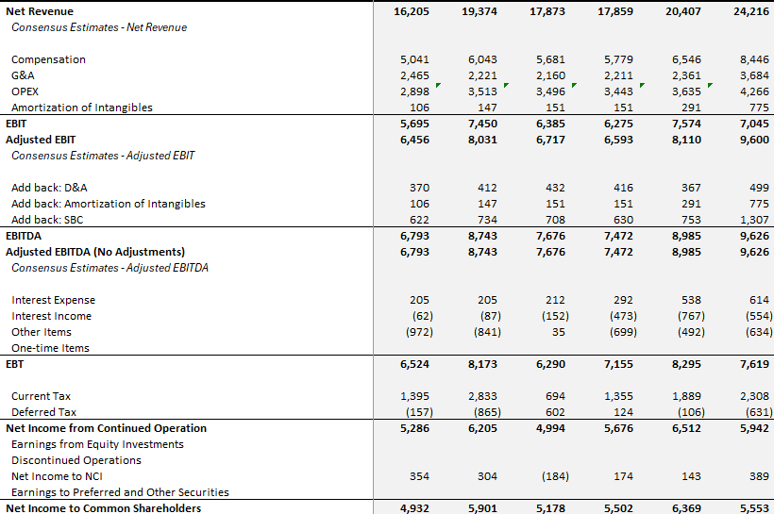

Slide 18
