Slide 1


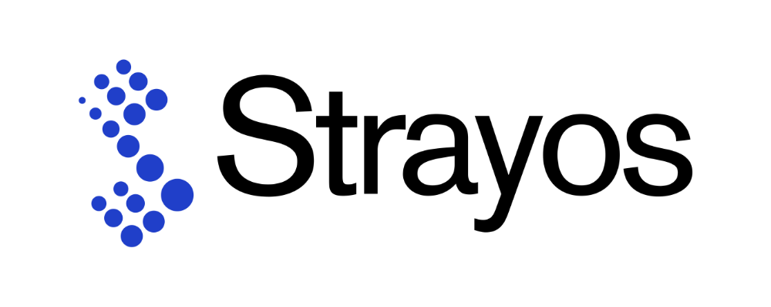
Strategic Levers for Growth: Elevating Strayos’ Customer Experience and Operational Efficiency
A consulting proposal delivered to Strayos

Slide 2

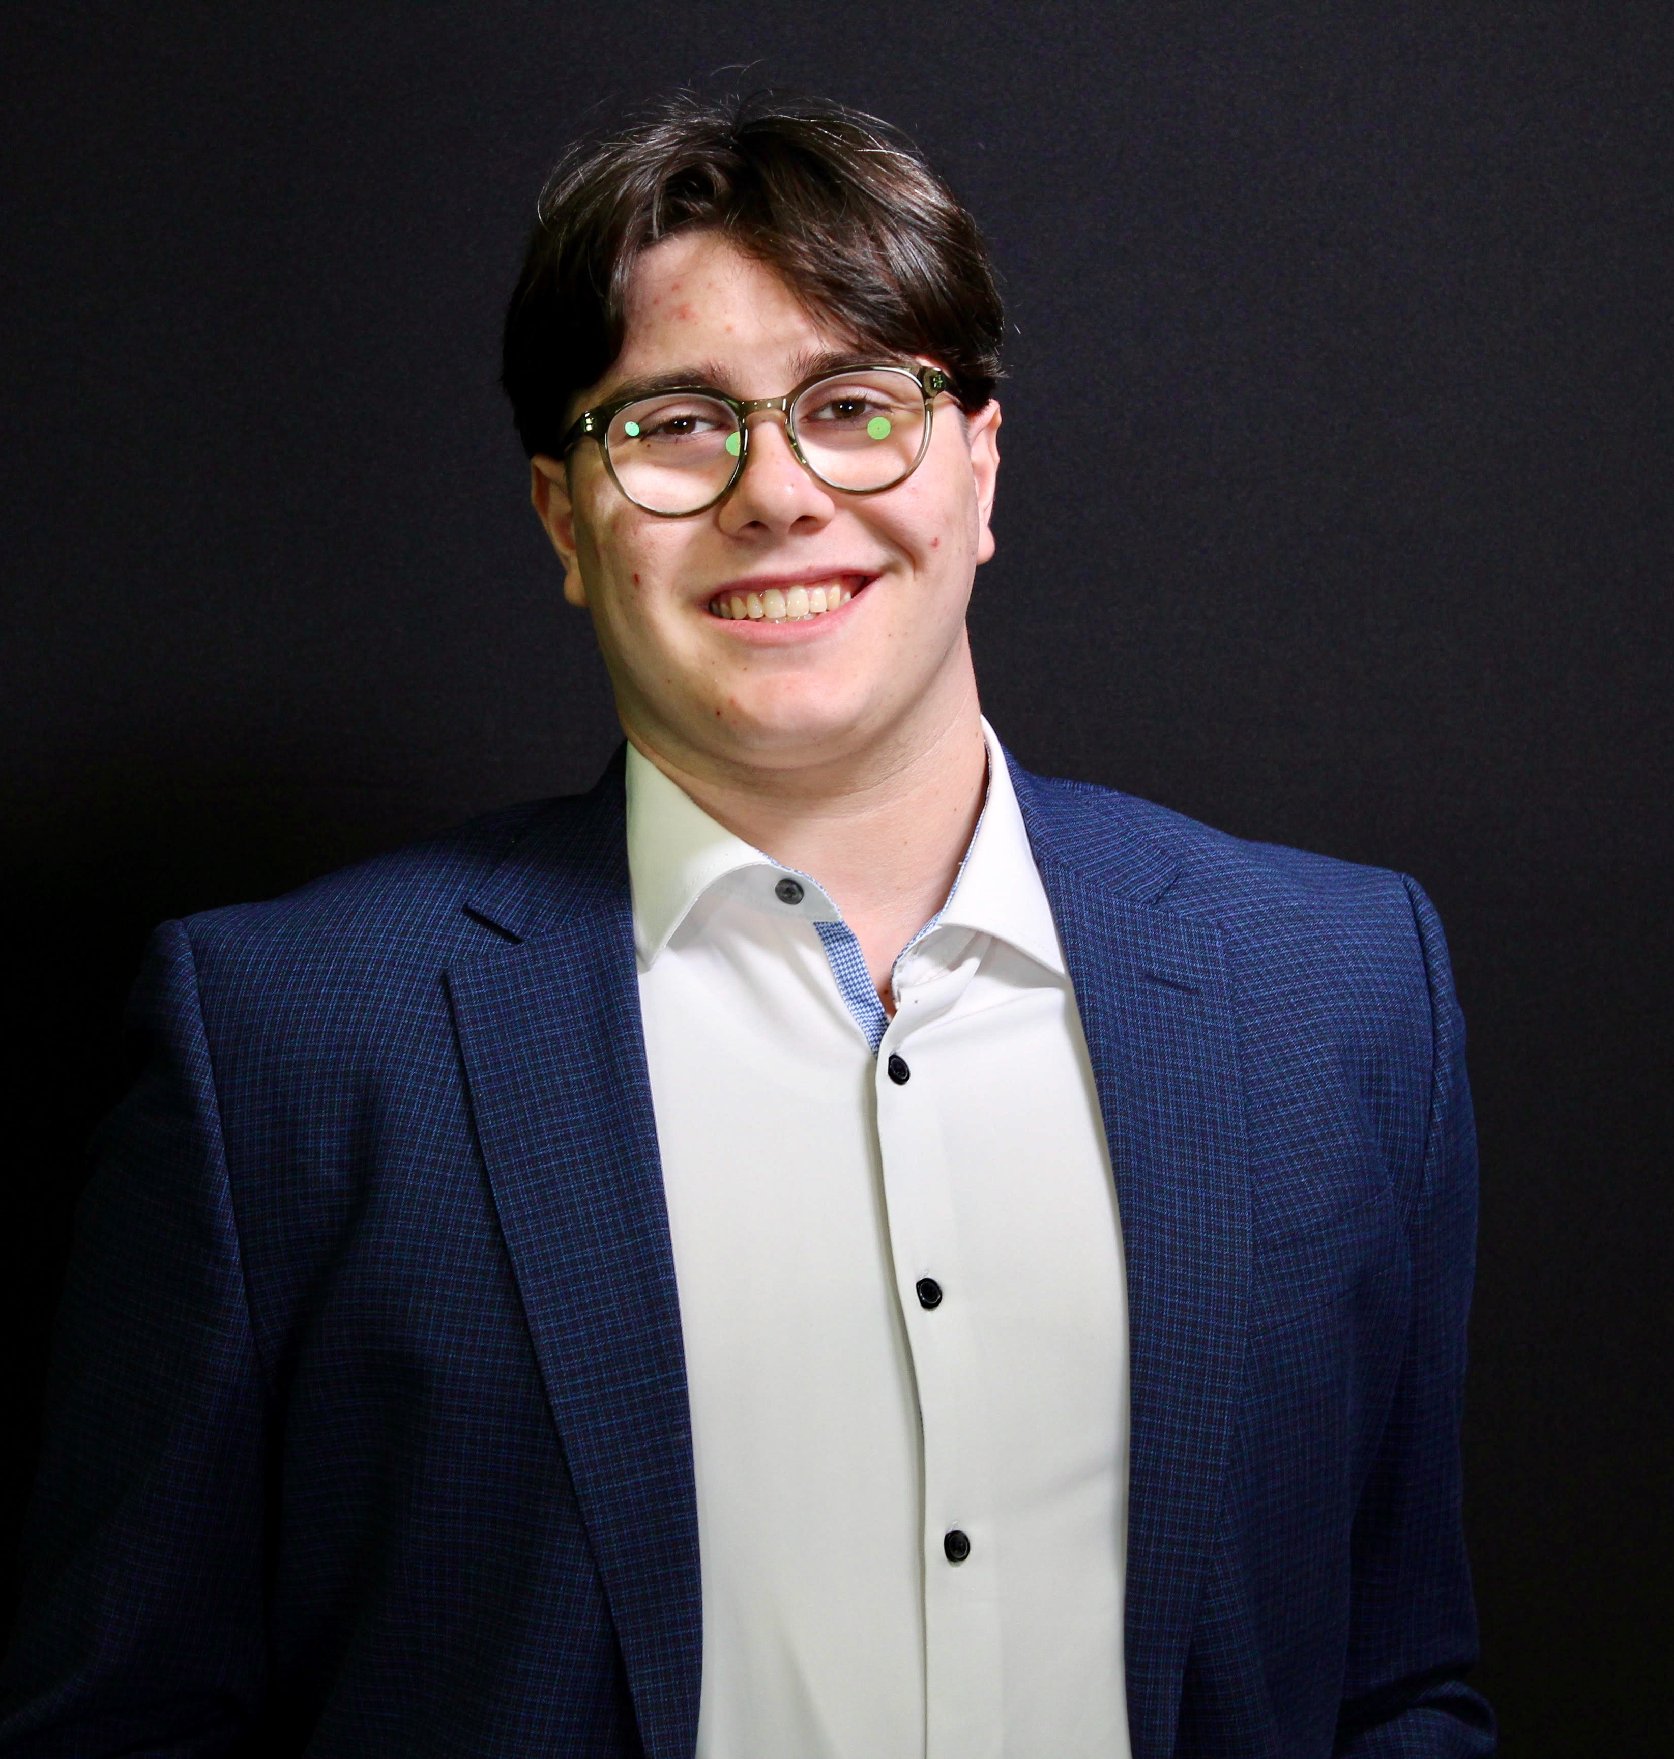





Team Overview
Arlet Garcia
Project Manager
Zach Sanders
Consultant
Lukas Warner
Consultant
Sheeshu Kandlakunta
Consultant
Melody Hayes
Consultant
Christian Sainristil
Consultant
Myles Manoli
Consultant

Slide 3



Strayos has a strong technical foundation but lacks the structure to scale market adoption
Regional firm headquartered in Buffalo, NY and founded in 2016
LinkedIn
Aims to implement Artificial Intelligence in the mining, drilling, and blasting process
More than 5,000 mines and quarries across 30 different countries
Challenges
Strayos struggles with brand visibility, limited customer acquisition, and go-to-market strategies
Source: Strayos

Slide 4

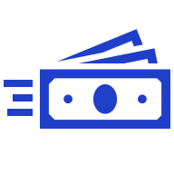

Implementation of Salesforce Marketing Cloud can lead to a 30% increase in customer satisfaction overall among companies
Adaptive
Innovative
Benefits
Experienced in working with smaller companies
Manageable learning curve allowing for quick use
47.3% of Salesforce clients have 0-100 employees
Customer-focused marketing and campaign strategies
Initiatives to attract and engage clients
Average order values have increased by 35% after 3 years
30% of companies experienced improved customer satisfaction
Greater exposure, brand recognition, and market share with opportunity to increase loyalty and customer retention
Source: Apps Run The World

Slide 5


Salesforce Marketing Cloud can boost site conversions by 60%
Revenue
Clients have experienced more than a $5M increase in incremental revenue
Efficiency
Saves 60% of time on marketing services and efforts
Site Interactions
Site conversion rates have increased by 60% 3 years after launch
Source: Apps Run The World
Notes:
-https://www.appsruntheworld.com/customers-database/products/view/salesforce-marketing-cloud
-https://embryo.com/blog/29-salesforce-stats/

Slide 6







Weekly newsletters will increase consumer retention & engagement
Competitor analysis of email marketing strategy
Implement weekly newsletter
Engages clients with a weekly mining-tech newsletter
Create newsletters highlighting product updates, industry insights, customer testimonials & case studies
Consistently pushes content via email
Runs a branded newsletter “Blasting and Beyond”, monthly on LinkedIn
Include client testimonials and reviews to build trust and credibility
Strayos’ current newsletter gap
Sign-up exists with no follow-through
Be as informative and engaging as possible
Inconsistent outreach, leading to potential readers being disengaged
Source: Business Dasher
Notes:
https://www.businessdasher.com/email-marketing-statistics/
https://embryo.com/blog/29-salesforce-stats/

Slide 7





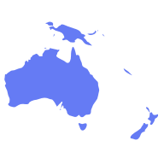

Boosting global visibility through SEO and paid search campaigns
Regularly update blog
Integrating Google ads
Maintain active blog posts
Organic results
Rank higher in searches
Targeted visibility in specific geographic regions, crucial for reaching mining hubs in regions such as Latin America, Australia and Africa.
61% of B2B marketers say SEO and organic traffic generate the most leads
Example: BioRender (SaaS Management Software Company)
83%
increase in conversions
Google Ads targets highly specific search terms, allowing Strayos to reach potential clients who are actively researching and ready to buy mining technology
51%
conversion rate
47%
lower cost per sign-up
Notes:
https://www.upgrow.io/blog/b2b-google-ads-case-study-biorender?utm_source=chatgpt.com
https://markitors.com/seo-statistics-that-prove-its-effectiveness-in-2023/
https://support.squarespace.com/hc/en-us/articles/205814568-Increasing-your-site-s-visibility-to-search-engines#toc-start-blogging
Competitor company does a good job with their website with the readability and visuals.
When you search “AI mining” on google, it does not show up.
Use relevant terms to the industry IE: AI mining software in titles and headlines
Invest in paid search
Release more content
Sposored results: Find a statistic of before and after of google ads can have ona. Business
Add how customers from Australia, names of clients, a sponsored ad on google can improve SEO but also engagement ina. Thriving market in Australia
Saas Management software, wat that is
Reword title
Points on why SEO is important
increase in SEO helps companies convert clients by x%
Add to bio render, how many companies dud they pull form the SEO impovements
Can you target certain countries with SEO

Slide 8

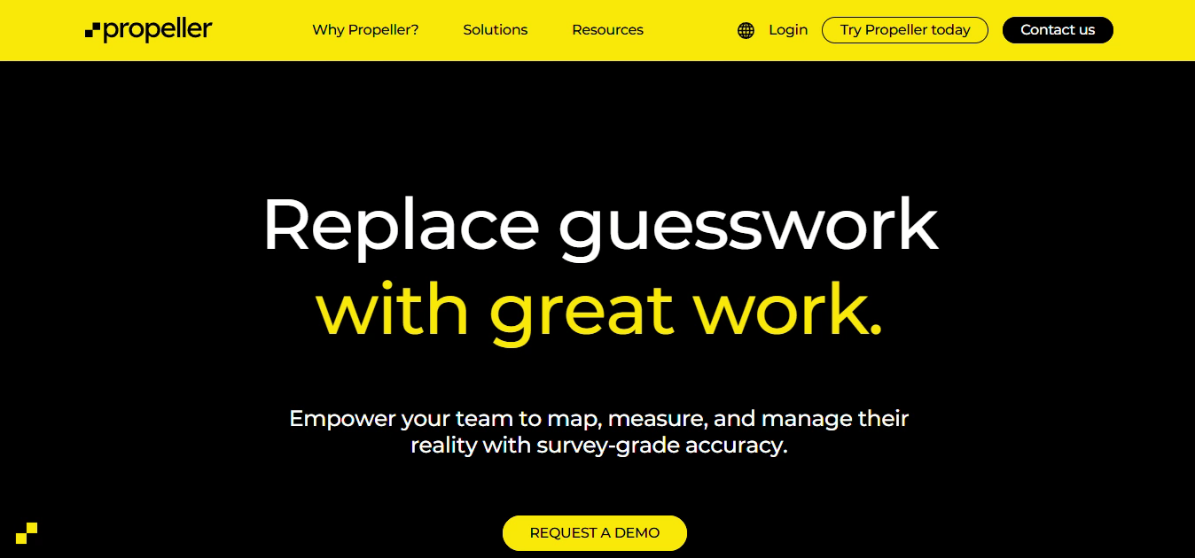


Implement website structural storytelling to increase brand recognition and information retention from customers
Rearrange site to prioritize storytelling via company mission and vision, specifically "efficiency, safety, and sustainability"
Move items such as the "AI Guide for Mining" away from the main page while still being easily accessed through ribbons
Implement competitor features such as live trackers and dynamic animations throughout the site
Sources: Stanford, Propeller
Notes:
Strayos has too many subsections, IE: what is ROI? Not many people may know what this means.
All the technical terms and detailed descriptions can be overwhelming for new visitors. Would be beneficial to put into more digestible vocabulary.
Strayos should also add a section where they show how to use their software rather than a youtube channel, where the videos can get lost.
IE: product features, support resources, case studies, success stories
Give the customers a reason why they should trust the company, give testimonial
Share success stories, write about road bumps during the project, interview the customers

Slide 9



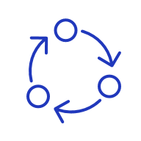


Strategic hiring drives improvements in sales and awareness
Full-time sales employees building client rapport can increase the likelihood of repeat purchases by 86%
Paid interns will increase outreach to new clients and create engagement between full-time employees
Hire 2-3 dedicated sales employees
Hire 1-2 sales interns to expand workforce bandwith and introduce fresh perspectives
Increase cold outreach/developing client relationships
Have rotational programs to give interns knowledge across all business processes
Apply commission, shown to boost motivation by roughly 57%
Pay at minimum wage ($15.50 in NY State) to provide a cost-effective method that entices quality candidates
Source: Captive IQ, Forbes

Slide 10
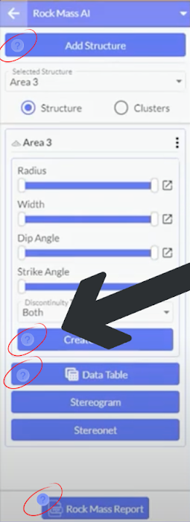


Improving onboarding times by integrating videos directly into Strayos software
Solution Overview
Question mark icons are displayed next to buttons and features to provide quick guidance within the software
When clicked a tutorial on that specific feature opens directly in the software
User Journey
User understands the feature
User sees ”?” Icon
User clicks the icon
The tutorial video opens

Slide 11
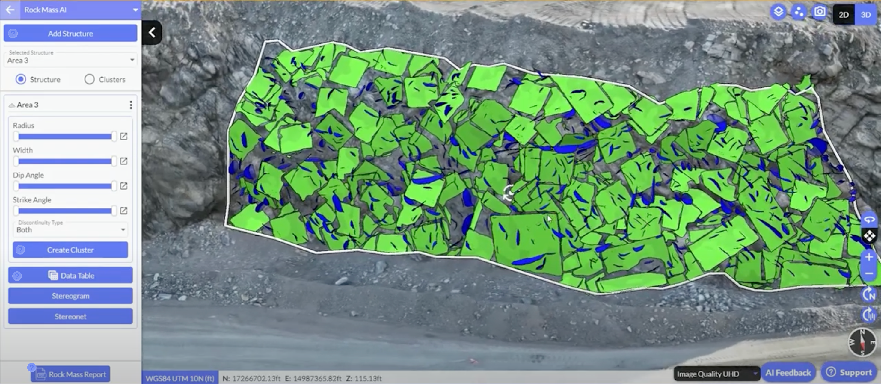
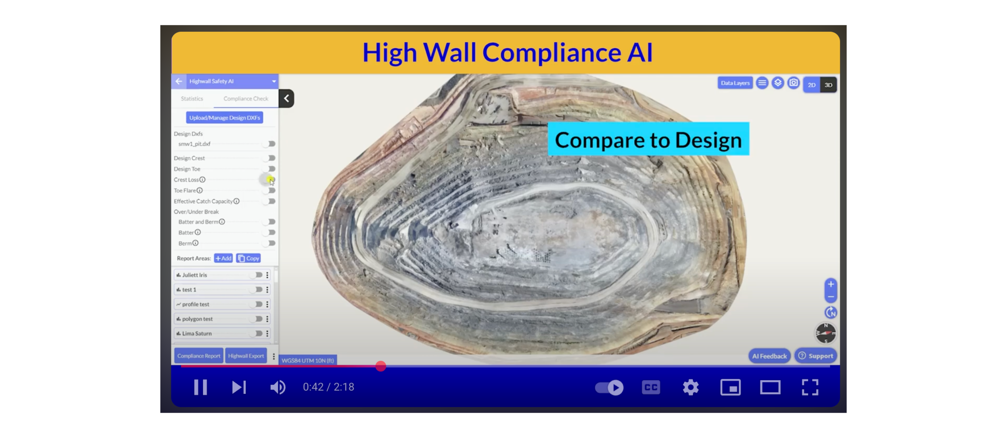

Preview of the solution being used on Strayos’ SaaS platform

Slide 12

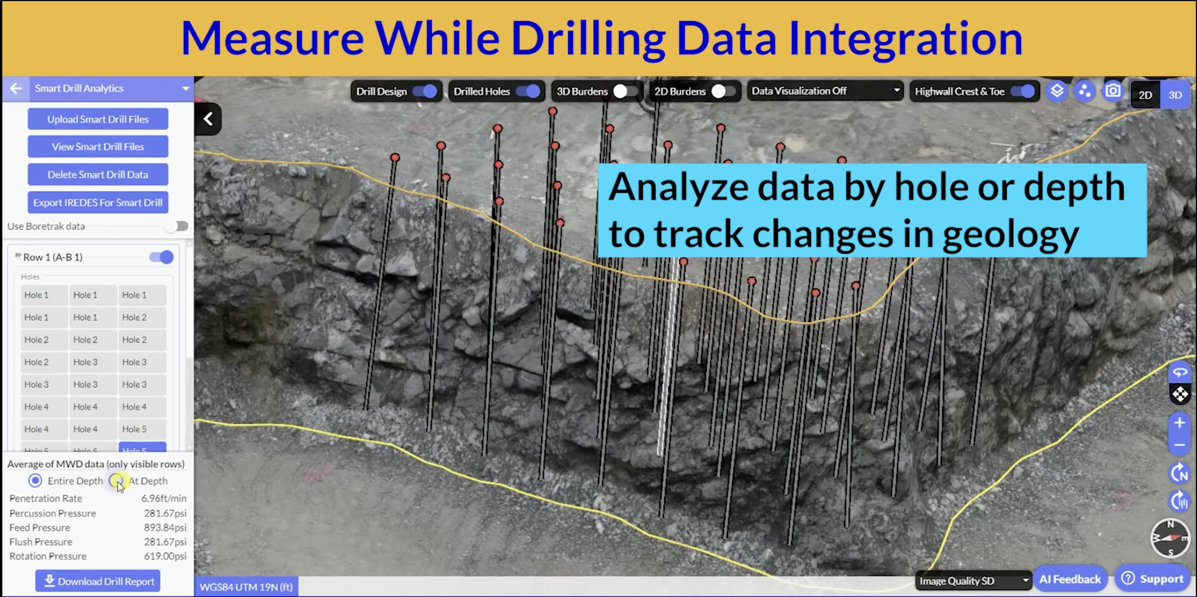
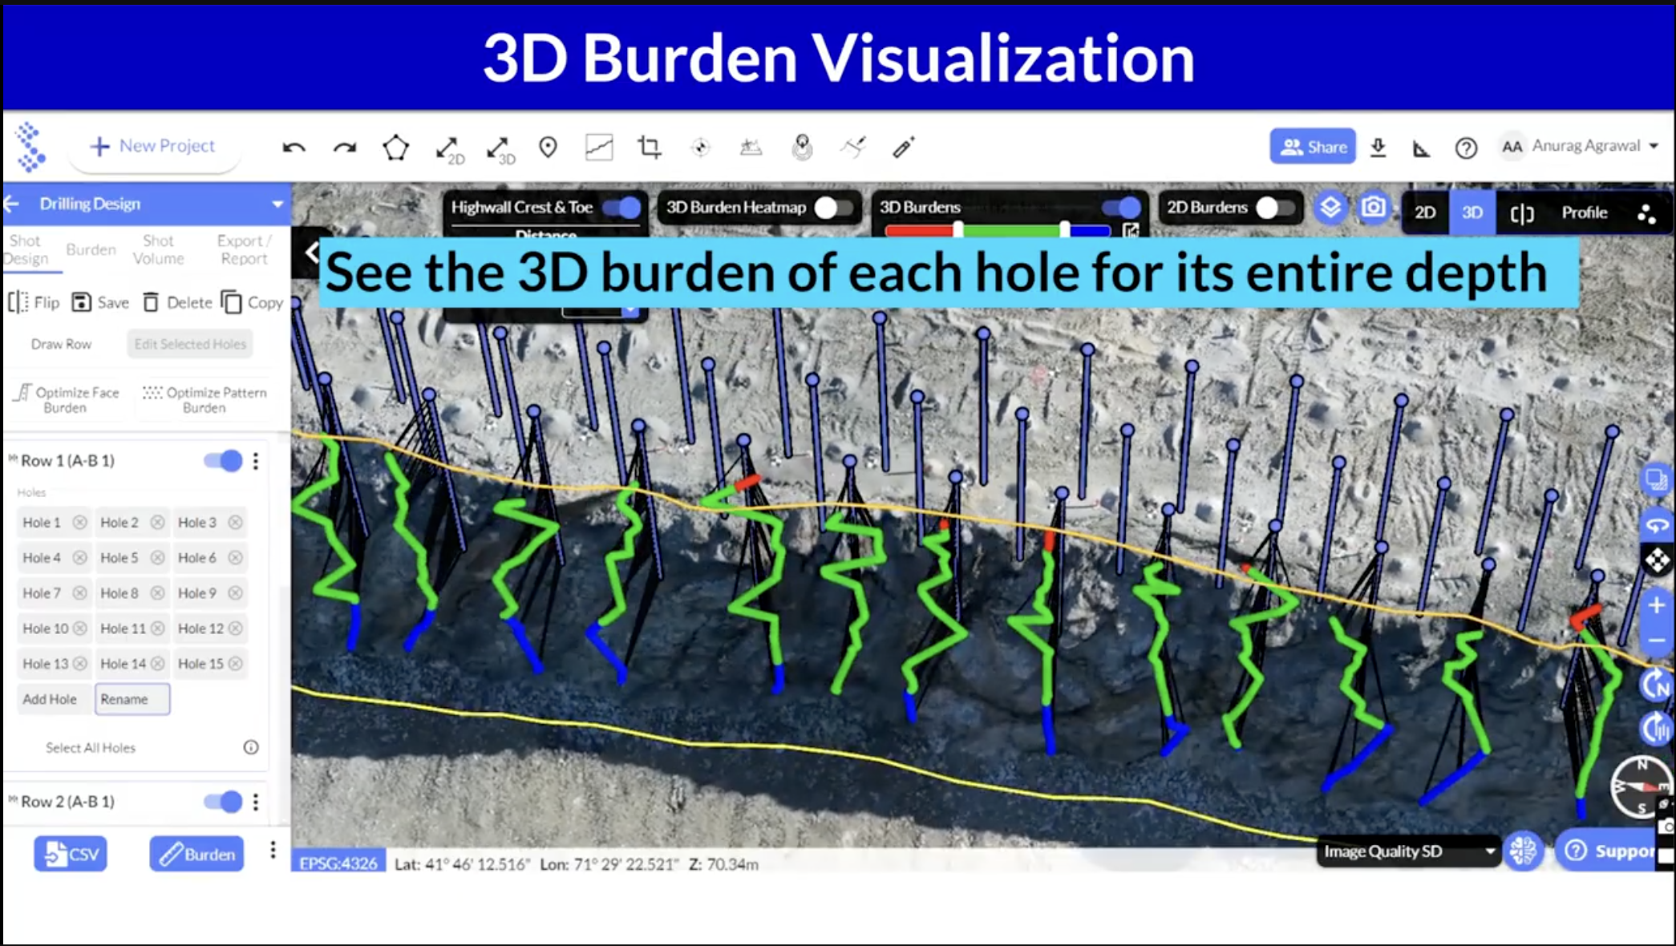

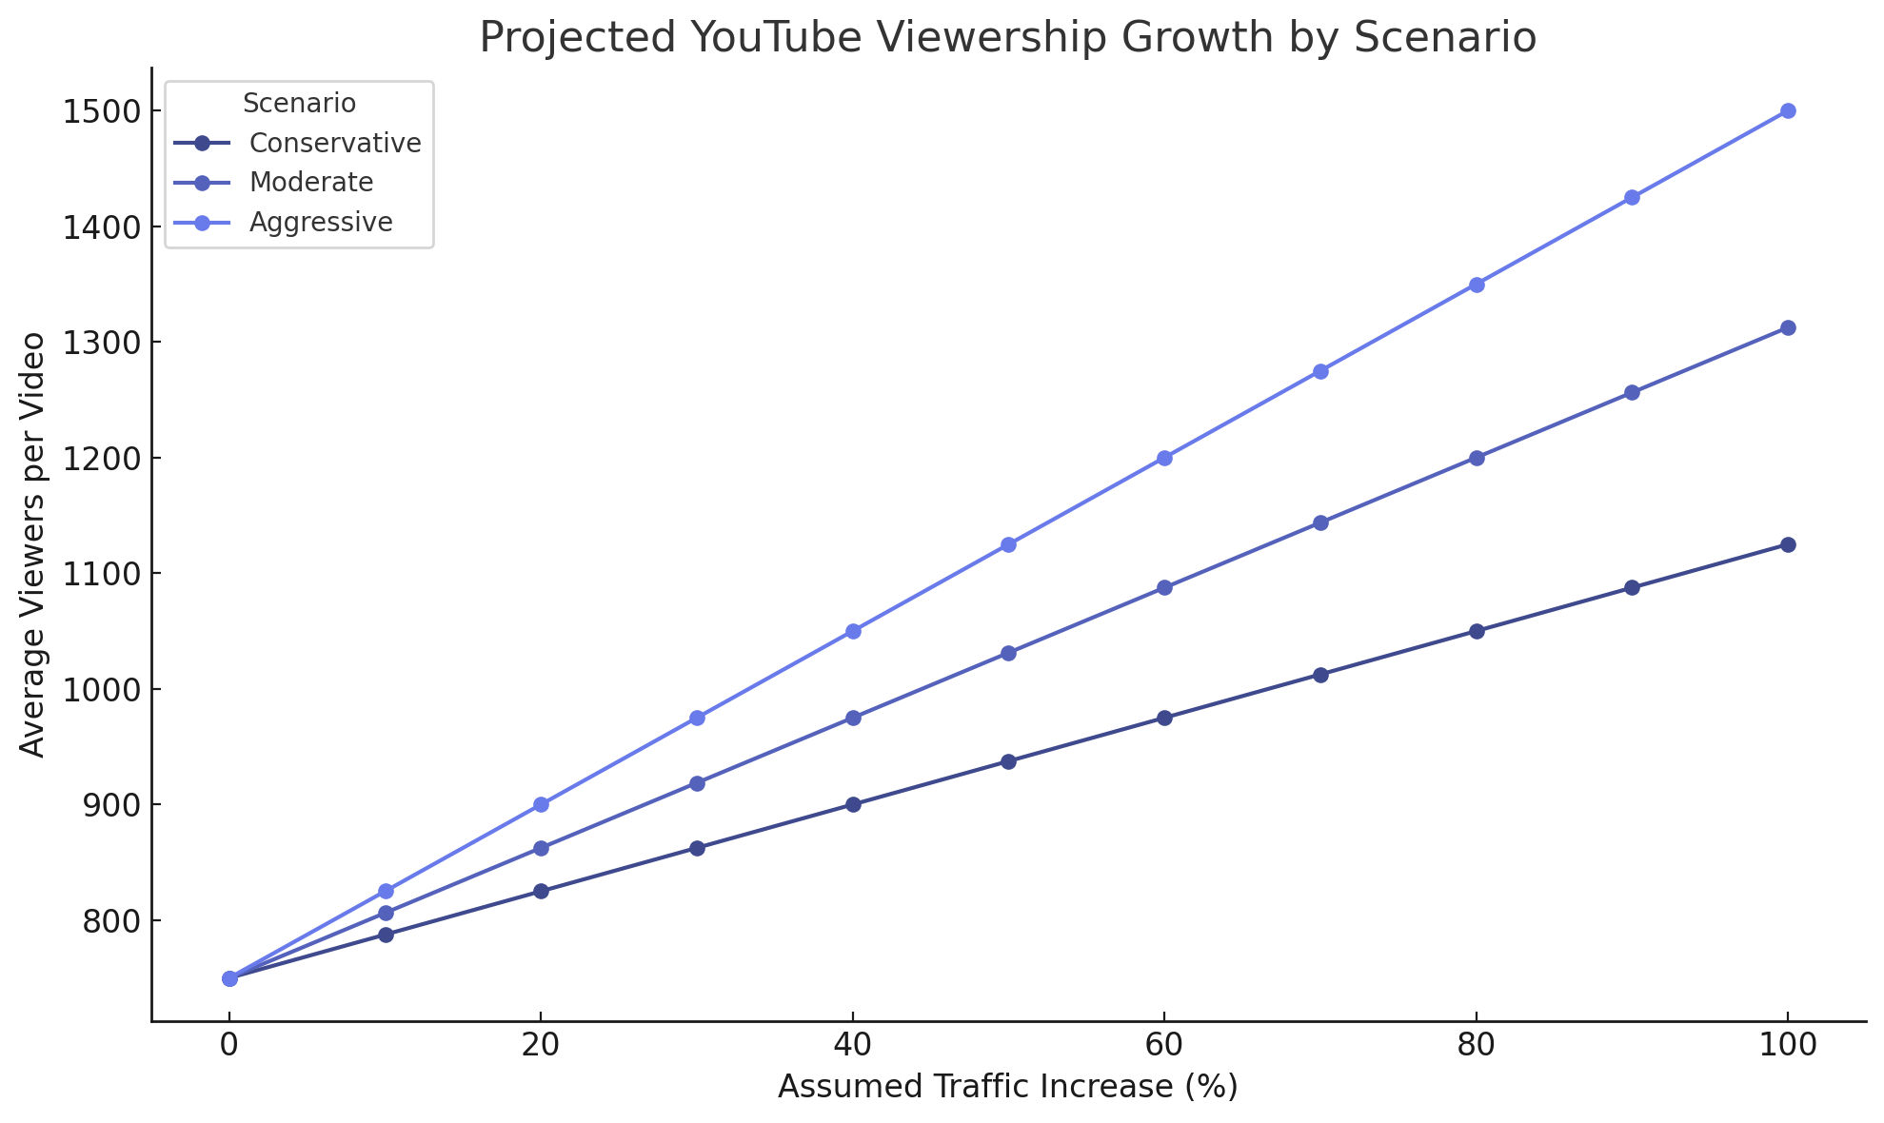
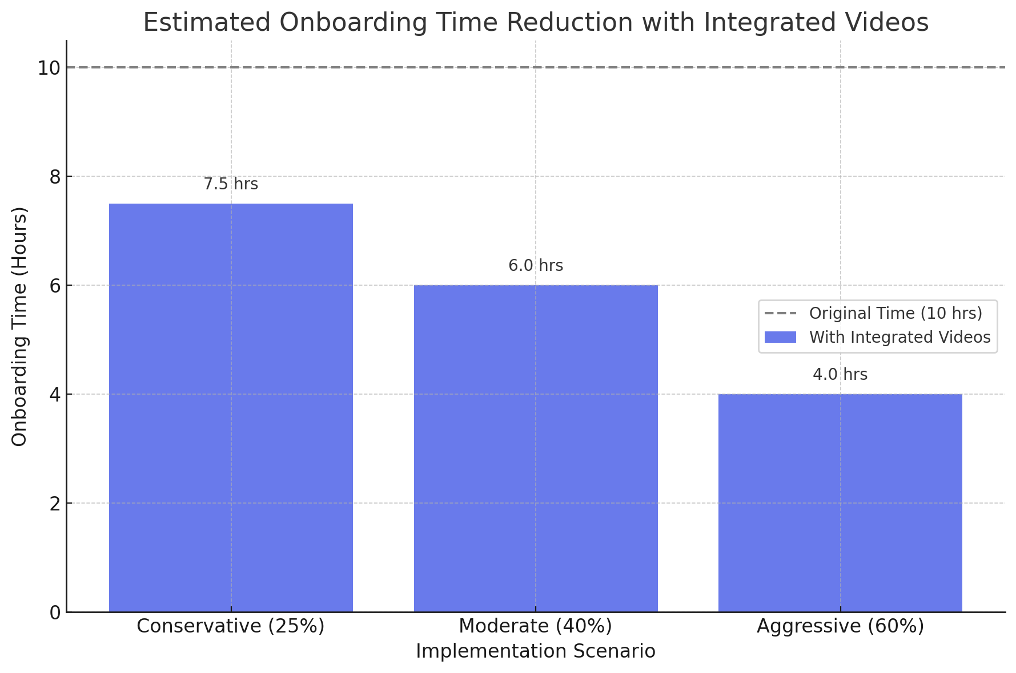

Driving user engagement and faster onboarding through integrated video access
Customers and users of the software would be given easy and efficient access to the portfolio of 200+ videos produced and posted by Strayos
Linkable features within the software will drive traffic directly to the Strayos YouTube page. Increasing views and boosting natural engagement
Onboarding time will be significantly reduced due to the time saved finding related video material on the Strayos YouTube page
Image Source: Adobe Express, Video Image Source: Strayos YouTube
Notes:
-https://www.appsruntheworld.com/customers-database/products/view/salesforce-marketing-cloud
-https://embryo.com/blog/29-salesforce-stats/
-https://www.marketscreener.com/quote/stock/SALESFORCE-COM-INC-12180/news/Salesforce-com-Organizations-See-Nearly-300-Return-on-Investment-with-Salesforce-Marketing-Cloud-42750686/

Slide 13
Driving user engagement and faster onboarding through integrated video access
Customers and users of the software would be given easy and efficient access to the portfolio of 200+ videos produced and posted by Strayos
Linkable features within the software will drive traffic directly to the Strayos YouTube page. Increasing views and boosting natural engagement
Onboarding time will be significantly reduced due to the time saved finding related video material on the Strayos YouTube page
Image Source: Adobe Express, Video Image Source: Strayos YouTube
Notes:
-https://www.appsruntheworld.com/customers-database/products/view/salesforce-marketing-cloud
-https://embryo.com/blog/29-salesforce-stats/
-https://www.marketscreener.com/quote/stock/SALESFORCE-COM-INC-12180/news/Salesforce-com-Organizations-See-Nearly-300-Return-on-Investment-with-Salesforce-Marketing-Cloud-42750686/

Slide 14
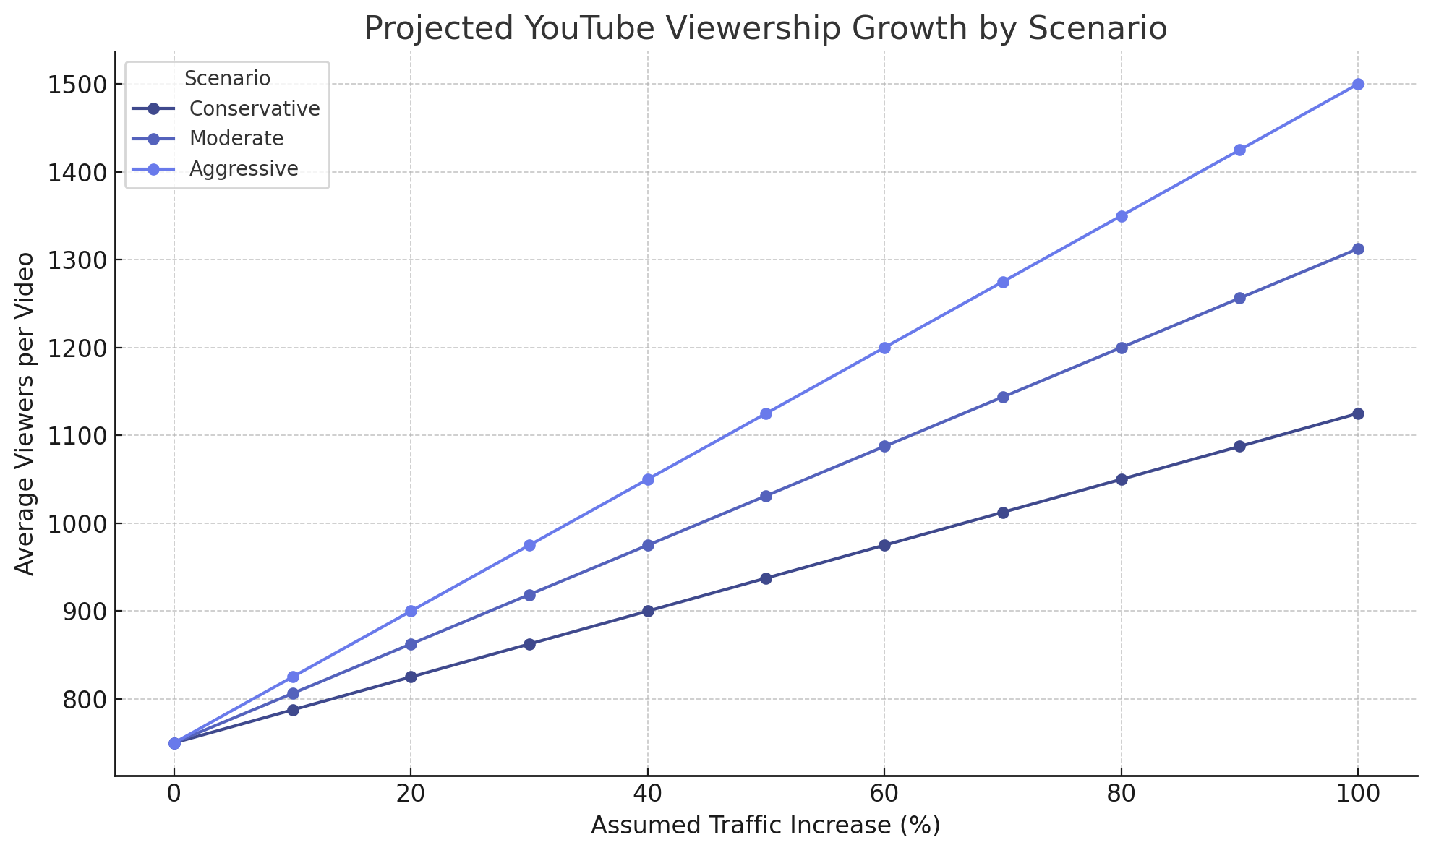


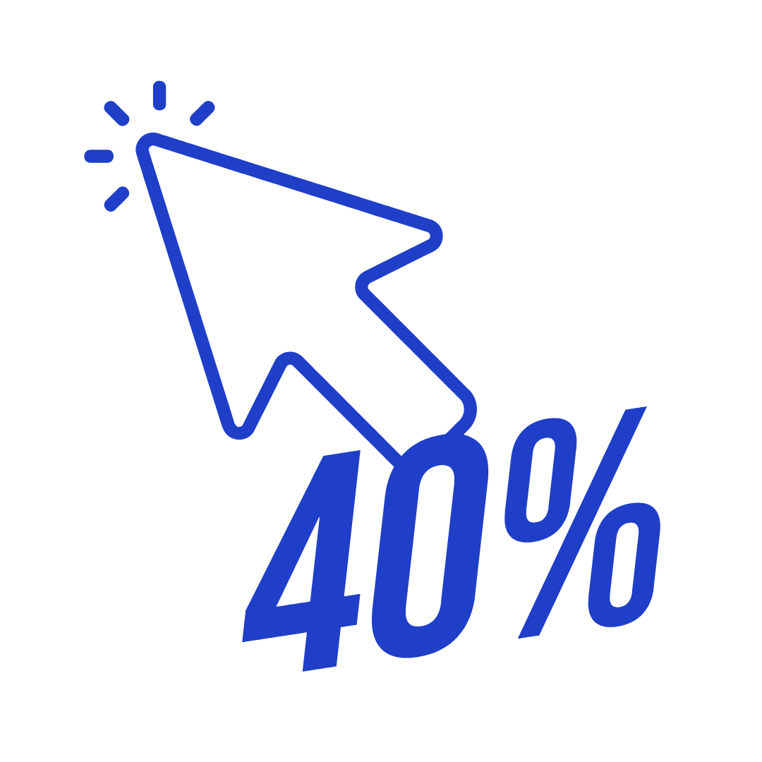
Assumptions made to create a projection of viewership increase
The metric assumes a current average video viewership of 750 based on the viewership of Strayos Academy videos
Uses 3 different efficiency outcomes; Conservative, Moderate, and Aggressive
Assuming a Click-Through rate of 40%, indicates that approximately 4 out of every 10 customers are expected to engage by clicking through to the YouTube page.
Source: Campaign Monitor

Slide 15
Driving user engagement and faster onboarding through integrated video access
Customers and users of the software would be given easy and efficient access to the portfolio of 200+ videos produced and posted by Strayos
Linkable features within the software will drive traffic directly to the Strayos YouTube page. Increasing views and boosting natural engagement
Onboarding time will be significantly reduced due to the time saved finding related video material on the Strayos YouTube page
Image Source: Adobe Express, Video Image Source: Strayos YouTube
Notes:
-https://www.appsruntheworld.com/customers-database/products/view/salesforce-marketing-cloud
-https://embryo.com/blog/29-salesforce-stats/
-https://www.marketscreener.com/quote/stock/SALESFORCE-COM-INC-12180/news/Salesforce-com-Organizations-See-Nearly-300-Return-on-Investment-with-Salesforce-Marketing-Cloud-42750686/

Slide 16


Assumptions made to create projection of the decrease in onboarding time
The metric assumes an average onboarding time of 10 hours
Uses 3 different efficiency outcomes; Conservative, Moderate, and Aggressive
Assumptions based on interview responses and industry averages
Notes:
-https://www.appsruntheworld.com/customers-database/products/view/salesforce-marketing-cloud
-https://embryo.com/blog/29-salesforce-stats/
-https://www.marketscreener.com/quote/stock/SALESFORCE-COM-INC-12180/news/Salesforce-com-Organizations-See-Nearly-300-Return-on-Investment-with-Salesforce-Marketing-Cloud-42750686/

Slide 17





Implementing software CRM Zapier, can save 400+ hours in onboarding within one year
Zapier is the #1 automation tool in the world
A case study done on TropicApp by Zapier showed over 400 hours of time saved through automation in one year of use
Zapier helps businesses save time and reduce manual work by automatically connecting and syncing data between different apps.
Easy to use — no coding needed
$0/month; $19.99/month; $69/month and custom
Connected with 7,000+ applications
Integrates by securely connecting to your software tools (like Salesforce, Gmail, or Slack) through APIs, allowing you to build automated workflows—called Zaps—without writing any code.
Source: tropicapp.io

Slide 18
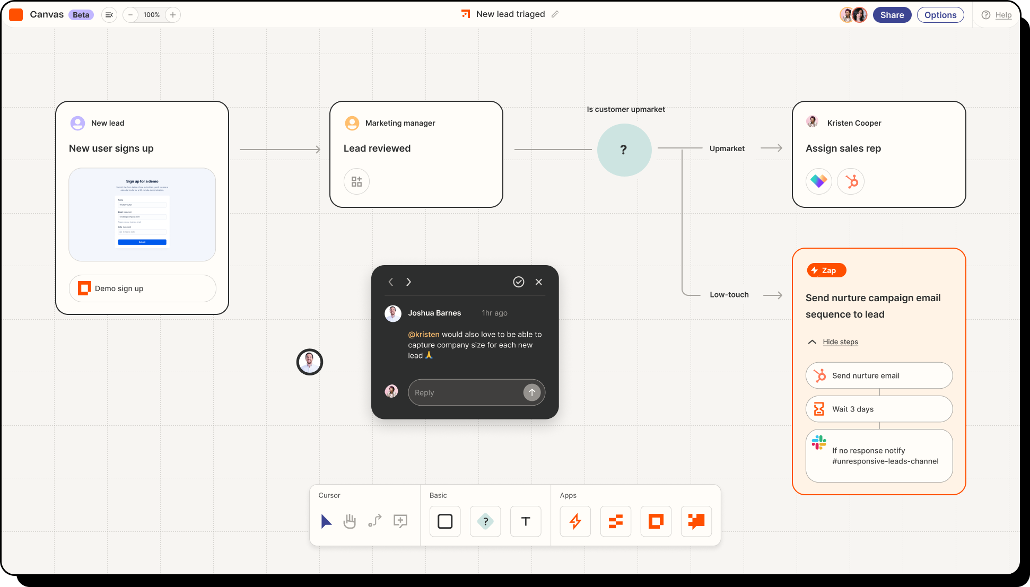
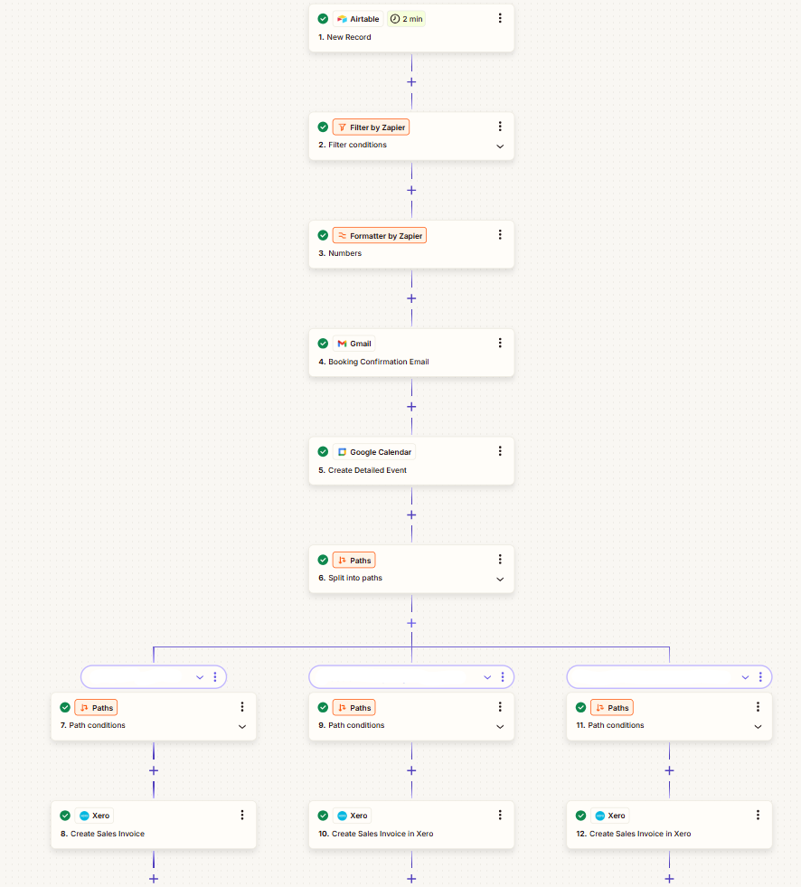


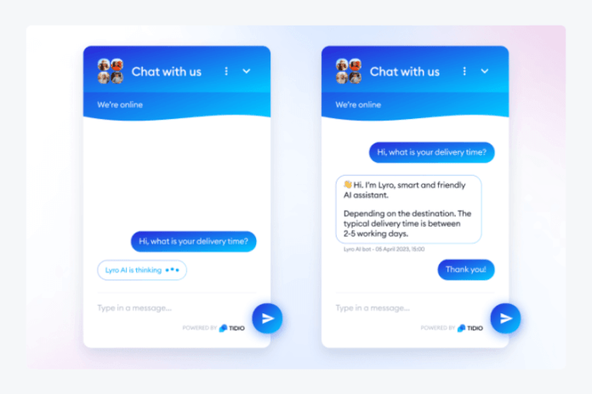

Improving client onboarding with an AI chatbot, Zapier, will automate data & improve client onboarding
Simplified onboarding
Easily scalable
Automated data

Slide 19


30% reduction in onboarding costs using automation
Money Saved on Customer Support
Money Saved vs % of Customer Support
that is automated
Money saved
Decrease in Onboarding time
% of Customer Support that is automated
More Automation will lead to higher ROI
Source: AI Marketing
Notes:
-https://www.appsruntheworld.com/customers-database/products/view/salesforce-marketing-cloud
-https://embryo.com/blog/29-salesforce-stats/
-https://www.marketscreener.com/quote/stock/SALESFORCE-COM-INC-12180/news/Salesforce-com-Organizations-See-Nearly-300-Return-on-Investment-with-Salesforce-Marketing-Cloud-42750686/

Slide 20


Potential to save up to 50% of time on manual tasks
Money saved on customer support
Time Saved (Minutes) vs % of Customer Support
that is automated
Time Saved (Minutes)
% of Customer Support that is automated
Decrease in onboarding time
An increase in customer support automation will lead to more time saved
Source: Psico-Smart
Notes:
-https://www.appsruntheworld.com/customers-database/products/view/salesforce-marketing-cloud
-https://embryo.com/blog/29-salesforce-stats/
-https://www.marketscreener.com/quote/stock/SALESFORCE-COM-INC-12180/news/Salesforce-com-Organizations-See-Nearly-300-Return-on-Investment-with-Salesforce-Marketing-Cloud-42750686/

Slide 21



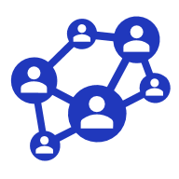


Improve customer touchpoints with the addition of LinkedIn Sales Navigator Advanced Plus
1. LinkedIn content quality
2. Follower count & growth trends
Strayos is currently at 8,505 LinkedIn followers
Growth rate is below competitors
Define content KPIs (engagement, reach)
Improve audience relevance by posting case studies to establish Strayos as a knowledgeable industry leader
No auto-invite or sponsored follower growth strategies causing deficiencies
Track trends in content performance over time to identify what types of content consistently perform well
Launch sponsored follower campaigns & leverage platform invites and audience targeting
Notes:
-https://www.appsruntheworld.com/customers-database/products/view/salesforce-marketing-cloud
-https://embryo.com/blog/29-salesforce-stats/
-https://www.marketscreener.com/quote/stock/SALESFORCE-COM-INC-12180/news/Salesforce-com-Organizations-See-Nearly-300-Return-on-Investment-with-Salesforce-Marketing-Cloud-42750686/

Slide 22




Improving customer touchpoints by eliminating deficiencies in the LinkedIn account
3. User engagement metrics
Current engagement rate is 70.63% which is lower than competitors
Identify high-performing content themes (images, videos, articles, etc)
4. Posting frequency/consistency
Create and maintain a content calendar
Analyze current posting times and days to identify peak engagement periods
Notes:
-https://www.appsruntheworld.com/customers-database/products/view/salesforce-marketing-cloud
-https://embryo.com/blog/29-salesforce-stats/
-https://www.marketscreener.com/quote/stock/SALESFORCE-COM-INC-12180/news/Salesforce-com-Organizations-See-Nearly-300-Return-on-Investment-with-Salesforce-Marketing-Cloud-42750686/

Slide 23








Solution: Utilize LinkedIn Sales Navigator Advanced Plus (SNAP) to improve sales and build a foundation to analyze future marketing data
5. Benefits of LinkedIn Sales Navigator
Action plan
  Identify & adopt new LinkedIn features
  Train the marketing team to integrate features into the content workflow
Surface intelligent & personalized insights
Improve sales efficiency & effectiveness
Develop better data foundations for better decision-making
Key features to leverage
Prospecting potential customers
Lead generation - run targeted campaigns
Lead management - use built-in CRM
Analytics - track & organize KPIs
Notes:
-https://www.appsruntheworld.com/customers-database/products/view/salesforce-marketing-cloud
-https://embryo.com/blog/29-salesforce-stats/
-https://www.marketscreener.com/quote/stock/SALESFORCE-COM-INC-12180/news/Salesforce-com-Organizations-See-Nearly-300-Return-on-Investment-with-Salesforce-Marketing-Cloud-42750686/

Slide 24
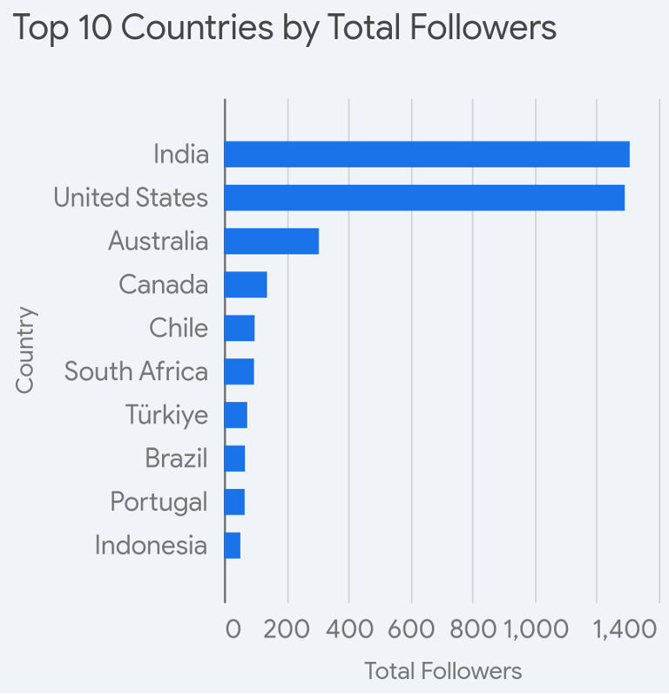
Broaden marketing campaigns to accommodate viewer personas
More attention required
Notes:
-https://www.appsruntheworld.com/customers-database/products/view/salesforce-marketing-cloud
-https://embryo.com/blog/29-salesforce-stats/
-https://www.marketscreener.com/quote/stock/SALESFORCE-COM-INC-12180/news/Salesforce-com-Organizations-See-Nearly-300-Return-on-Investment-with-Salesforce-Marketing-Cloud-42750686/

Slide 25
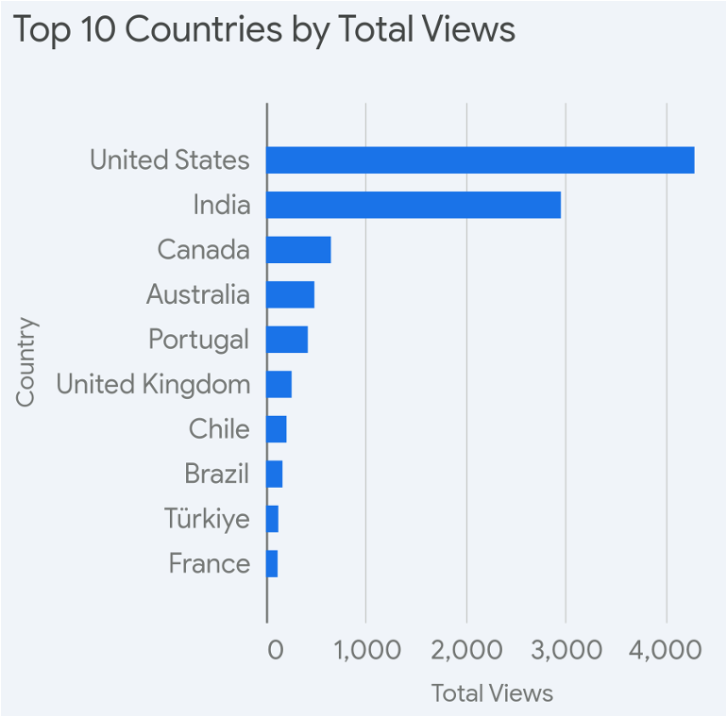
Broaden marketing campaigns to accommodate viewer personas
Viewership > Followers
Total views exceed Total followers by thousands of users. This indicates that the marketing is not being maximized to capture followers
Recommendation:
  Create targeted posts tailored to specific job functions (i.e. engineering, operations, etc)
  Launch geo-based campaigns to improve viewership across countries
Notes:
-https://www.appsruntheworld.com/customers-database/products/view/salesforce-marketing-cloud
-https://embryo.com/blog/29-salesforce-stats/
-https://www.marketscreener.com/quote/stock/SALESFORCE-COM-INC-12180/news/Salesforce-com-Organizations-See-Nearly-300-Return-on-Investment-with-Salesforce-Marketing-Cloud-42750686/

Slide 26
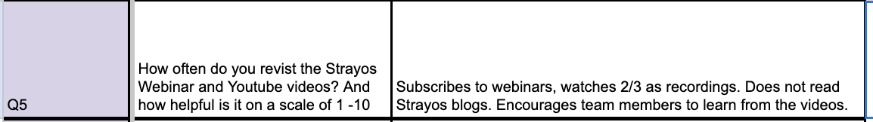
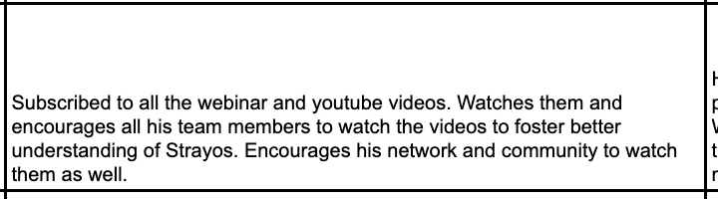
Appendix.
Interview with Patrick – Notes by Lucas
Company: Holcim - Patrick Ebeling Notes by Zach
Notes:
-https://www.appsruntheworld.com/customers-database/products/view/salesforce-marketing-cloud
-https://embryo.com/blog/29-salesforce-stats/
-https://www.marketscreener.com/quote/stock/SALESFORCE-COM-INC-12180/news/Salesforce-com-Organizations-See-Nearly-300-Return-on-Investment-with-Salesforce-Marketing-Cloud-42750686/

Slide 27
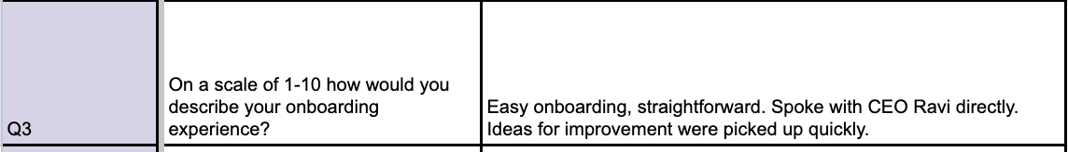
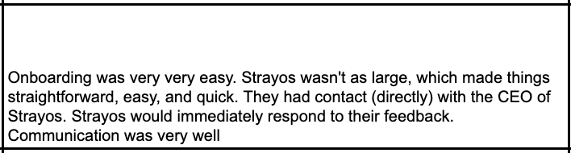
Appendix.
Interview with Patrick – Notes by Lucas
Company: Holcim - Patrick Ebeling Notes by Zach
Notes:
-https://www.appsruntheworld.com/customers-database/products/view/salesforce-marketing-cloud
-https://embryo.com/blog/29-salesforce-stats/
-https://www.marketscreener.com/quote/stock/SALESFORCE-COM-INC-12180/news/Salesforce-com-Organizations-See-Nearly-300-Return-on-Investment-with-Salesforce-Marketing-Cloud-42750686/

